Slide 1

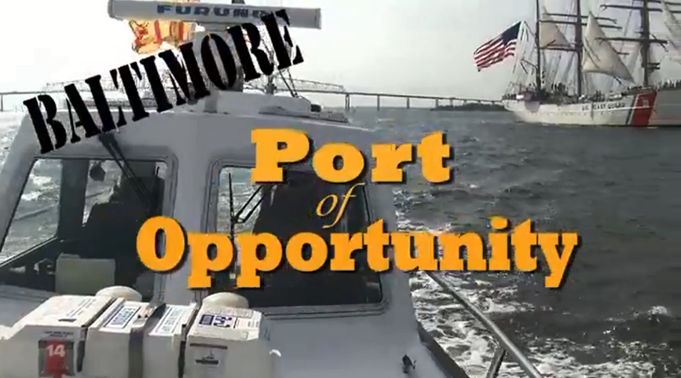
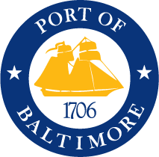
Maryland Port Administration
Baltimore: Port of Opportunity
Video

